Slide 1
Single Page Web Apps
Get your buzzword-bingo sheets out :P
Jan Monschke
Eray Basar

Slide 2
#!/bio
Jan Monschke
  Coffeescript / brunch / CouchApps / Brunch-Colors
  @thedeftone / http://github.com/janmonschke
Eray Basar
    @toshiyori
@9elements : @imgly, @watchlaterapp

Slide 3
#!/index
The big picture
What the #! is a Single Page Web App?
Why would I do that?
Why wouldn‘t I do that?
What tools are there?

Slide 4

The big picture: Apple‘s ecosystem

Slide 5

Is the web the saviour?
f JavaScript
CSS3 4
HTML5 4
f REST

Slide 6
Is the web the saviour?
From a developer‘s perspective
  Solve distribution
  Get low tech API access (Device API)
From a users‘s perspective
  Harmonize UI concepts / overall UX
  Web apps have to feel more native

Slide 7
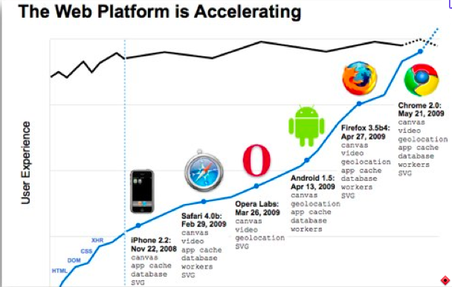
Web Apps have to feel more native
Desktop- and Web-Experience converge!
http://www.yuiblog.com/blog/2009/10/13/video-neuberg-html5/

Slide 8
Desktop- and Web-Experience converge
Then:
  Flash
Now:
  JavaScript
  AJAX
  JavaScript is everywhere (Frontend, Backend, DB)
  Single Page Web Apps

Slide 9
#!/what
http://twitter.com/ / http://facebook.com
Your whole app exists on a single page
  No complete reload of the DOM
  Only parts of your page change
In-App URLs: mydomain.tld/#!/test
  bookmarkable
  client-side routing

Slide 10
#!/why
Server doesn‘t need to render complete layouts
  Less CPU time needed for each request
  Server is able to handle more requests
No huge HTML files are transported
  Less data → less time for transport → Good for UX and Backend
  Especially good for devices that are connected to mobile networks

Slide 11
#!/why/2
Transitions between states
  Immediate Feedback and Interaction Response
  Elegant way to lead the user through complex processes
Web is not silent
  Reintroduction of music experience through-out the Web
  Separate information flows are not interrupted (chat, music player, file transfers...)

Slide 12
#!/why/not
Existing page with a good pagerank, hundreds of indexed urls
  gawker.com → All links from Google were broken
Intensive Data
  You shouldn‘t develop a banking page like that
  Inspect Element / See source → Your business logic exposed to the user
Your page relies on the JavaScript performance of your clients
  bad UX with slow browsers
  Make sure JavaScript is enabled (<noscript/> ftw!)

Slide 13
#!/tools
Backbone.js - http://documentcloud.github.com/backbone/
  MVC – in JavaScript
  Easy Backend integration
SammyJS - http://sammyjs.org/
brunch - https://github.com/brunch/brunch
  Toolchain for Single Page Web Apps
  Clean project structure → automatic builds
  Buzzword mayhem: CoffeeScript / Backbone.js / Eco / Stylus

Slide 14
#!/hosting
Easily integration into all REST backends
  Rails / AppEngine / you name it
The missing link for nodejs?
  There‘s no Rails for nodejs (yet)
  Single Page Web Apps + nodejs = Awesomeness

Slide 15
#!/thx
Any questions?
Feel free to contact us via Twitter:
@thedeftone @toshiyori

